Slide 1
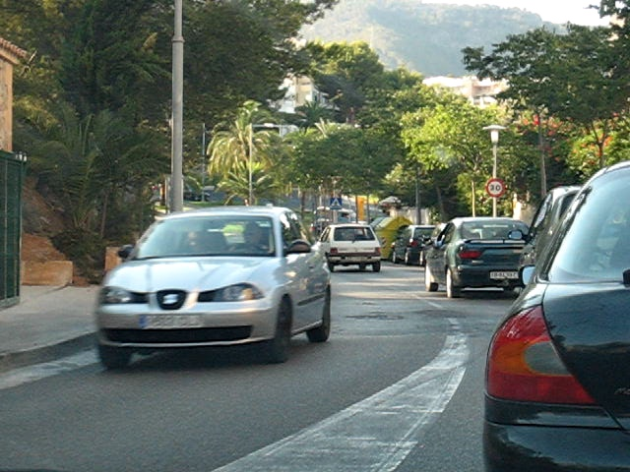
Optical Flow Estimation Using Block Matching with Weighted Median Filtering
Twan Koolen and James Noraky
December 8, 2014

Slide 2
Motivation
Modern optical flow algorithms (e.g. Classic++) are accurate but slow
Optimization techniques like coarse-to-fine optimization, GNC optimization, etc. are slow
Block matching algorithms are fast but inaccurate
Compromise: a method that is faster than coarse-to-fine optimization but more accurate than block matching
Notes:
Stress 2 angles video compression

Slide 3
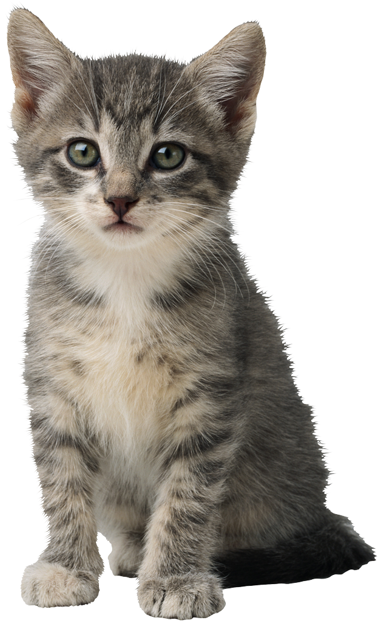
Block Matching
Block matching is used to find the motion of blocks of pixels across consecutive video frames
Matching criteria include: Sum squared difference, Sum absolute difference, normalized correlation
Frame 1
??
✪
Frame 2
Compute normalized
correlation
Find point that corresponds to maximum
Notes:
Block matching is not very good

Slide 4
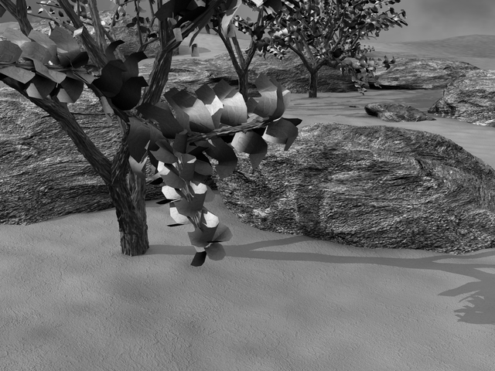
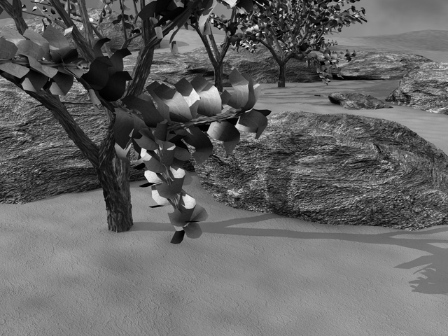
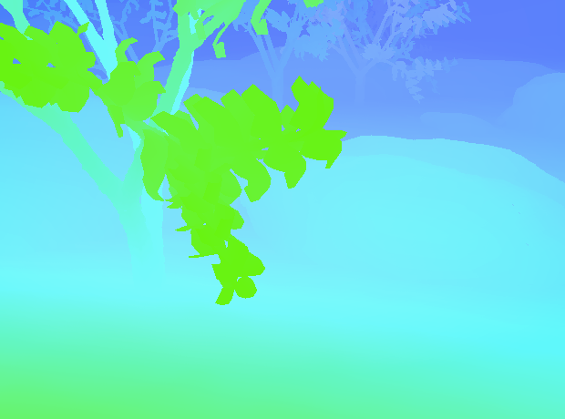
Example Input Images
Ground truth:
Notes:
Slow but nuggets (weighted median filter) we can take from it

Slide 5
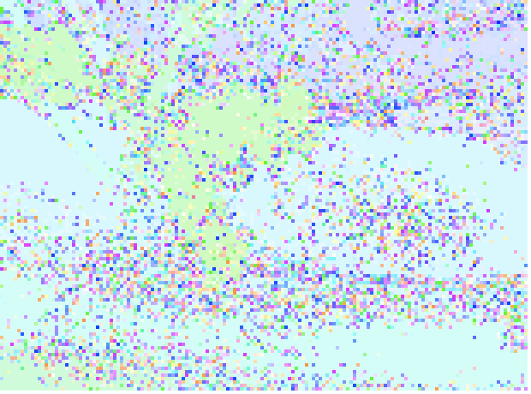
Block Matching Example
Raw Block Matching
Ground Truth
Block matching output is noisy and requires additional processing.

Slide 6
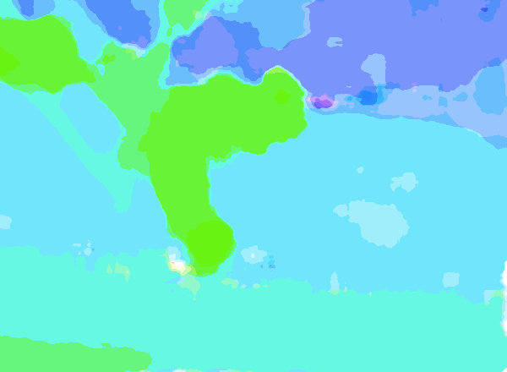
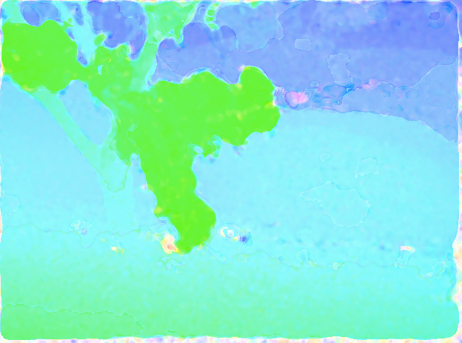
Our Proposed Method
Warp
Frame 2
Block Matching
Median Filtering
Differential Method
Frame 1
Notes:
Slow but nuggets (weighted median filter) we can take from it

Slide 7
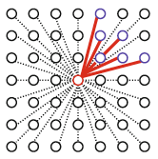
Weighted Median Filter
Smoothens rough optical flow estimate from block matching
Higher weight for pixels in window that are:
Close
Similar in intensity/color
Output: 50% weighted percentile
7
7
Notes:
Show example of

Slide 8
Differential Method
Taken from Classic++, method similar to Horn-Schunk
Data term
Smoothing term
Not good at large displacements
Fills in the details
Notes:
Show example of

Slide 9
Evaluation
Used Middlebury Optical Flow Training Set (n=6)
Evaluated our proposed methods (with regular and weighted median filtering) and Classic++ against ground truth flow
Evaluation Metrics
Time (seconds)
Average Angular Error (AAE)

Slide 10
Results
 | Block Matching |  | Our Method |  | Classic++
Name | Time (s) | AAE (deg) | Time (s) | AAE (deg) | Time (s) | AAE (deg)
Rubber Whale | 21 | 10.4 | 86 | 5.6 | 210 | 3.8
Grove2 | 29 | 7.4 | 142 | 5.6 | 316 | 2.2
Dimetrodon | 23 | 11.1 | 89 | 8.0 | 215 | 1.9
Hydrangea | 20 | 10.0 | 89 | 8.8 | 217 | 6.8
Grove3 | 30 | 12.9 | 141 | 11.6 | 312 | 6.3
Venus | 15 | 13.8 | 55 | 15.4 | 139 | 4.4
Average | 23 | 10.9 | 100 | 9.2 | 235 | 4.2
We achieve reasonable AAE using our approach while reducing the computation time by at least 2x.

Slide 11
Results (con’t)

Slide 12
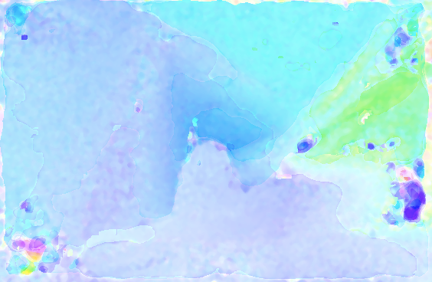
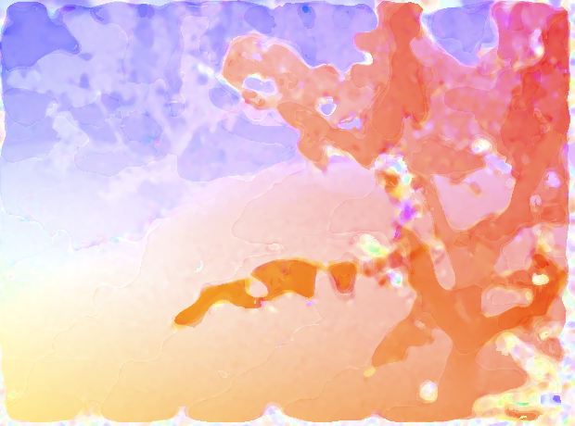
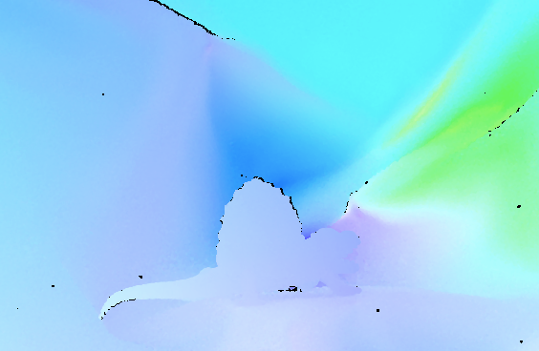

Results (con’t)
Dimetrodon
Grove 2
Grove 3
TOP: Flow estimates obtained by our approach
BOTTOM: Ground truth flow

Slide 13

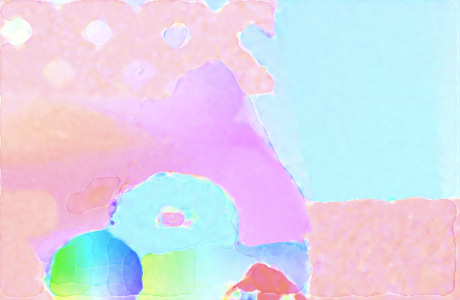


Results (con’t)
Hydrangea
Rubber Whale
TOP: Flow estimates obtained by our approach
BOTTOM: Ground truth flow

Slide 14
Contributions
Faster than coarse-to-fine optimization
More accurate than block matching
Weighted median filtering not better than regular median in this dataset

